Slide 1
GRAPH THEORY
Dijkstra Implementation
Applying Dijkstra without priority queue
Members:
Daniyal Fahim 22k-4282
Daiyan Ur Rehman 22k-4167
Dawood Adnan 22k-4663
https://dijkstra-visualization-sandy.vercel.app/

Slide 2
Scope:
Algorithm implemented in C++ and Python to analyze efficiency and performance differences.
Graph visualization created using React.js and JavaScript.
Implementation Details
Language Comparison:
C++ and Python were selected to compare execution times for various test cases.
Each implementation adheres to a brute-force approach, focusing on simplicity and correctness.
Visualization:
Graphs were visualized using React.js for better understanding of shortest paths and graph connectivity.

Slide 3
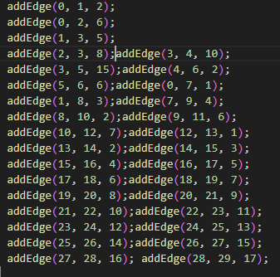
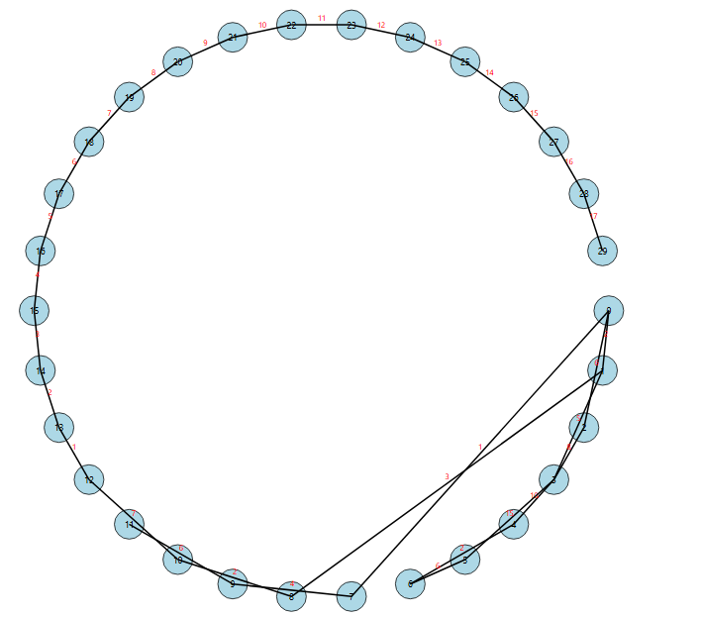
Test Case # 1

Slide 4
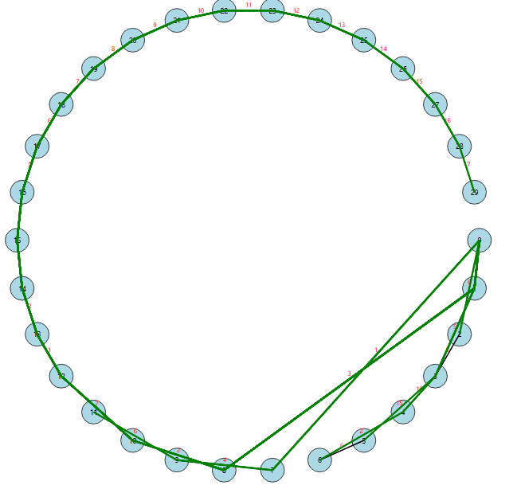
Test #1
CPP: 432,254 µs
Python: 411,553.6 µs
Python is ~4.78% faster than CPP

Slide 5
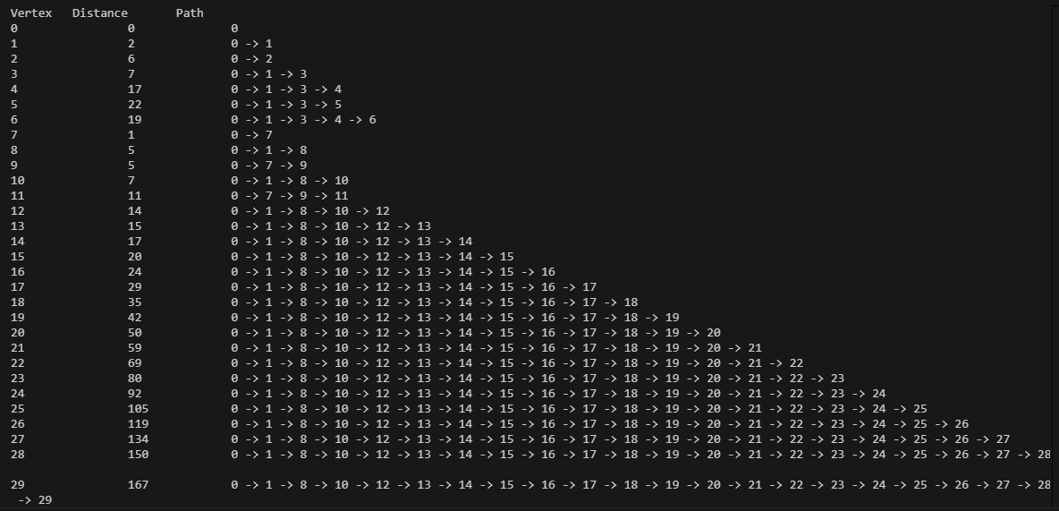
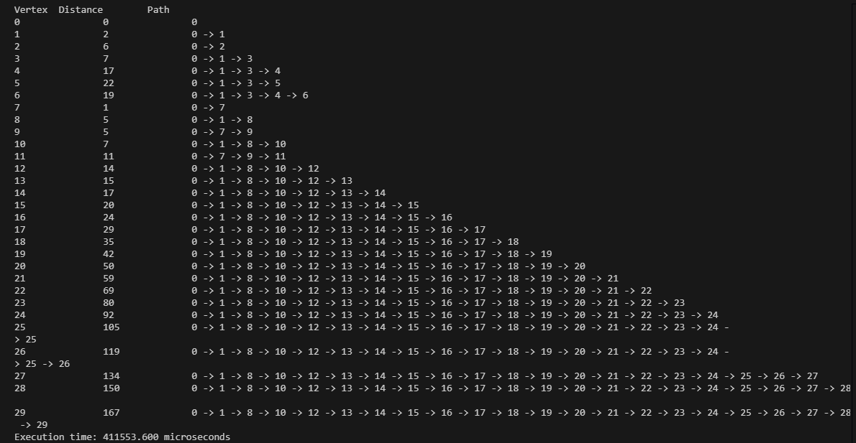
CPP: 432,254 µs
Python: 411,553.6 µs

Slide 6
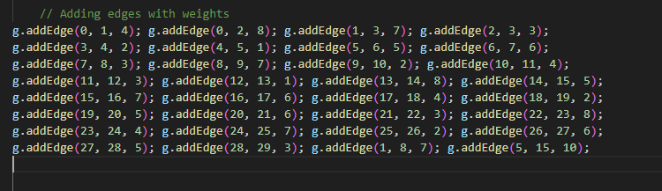
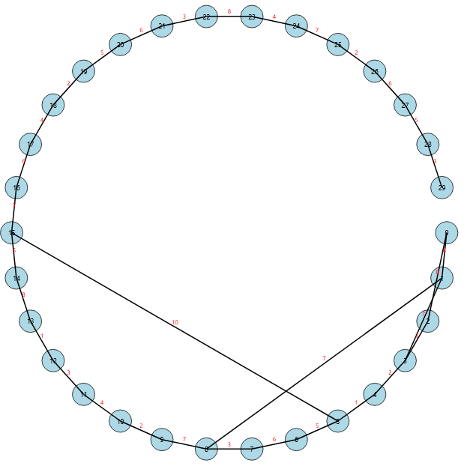
Test Case # 2

Slide 7
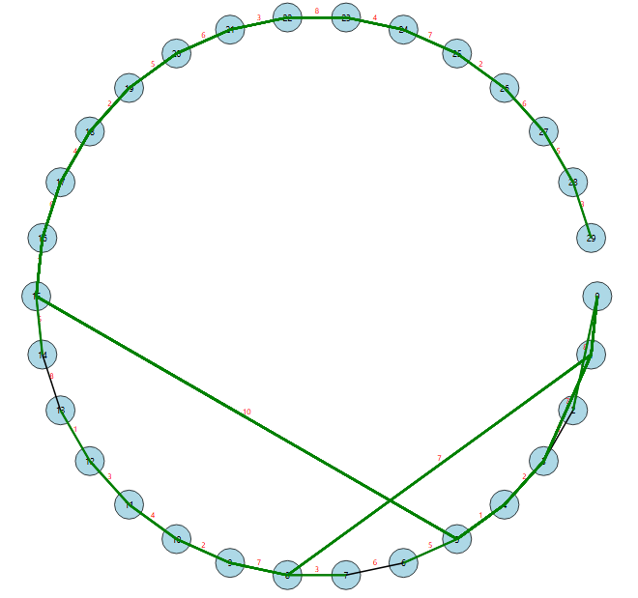
Test #2
CPP: 148,696 µs
Python: 19,764.7 µs
Python is ~87.71% faster than CPP

Slide 8
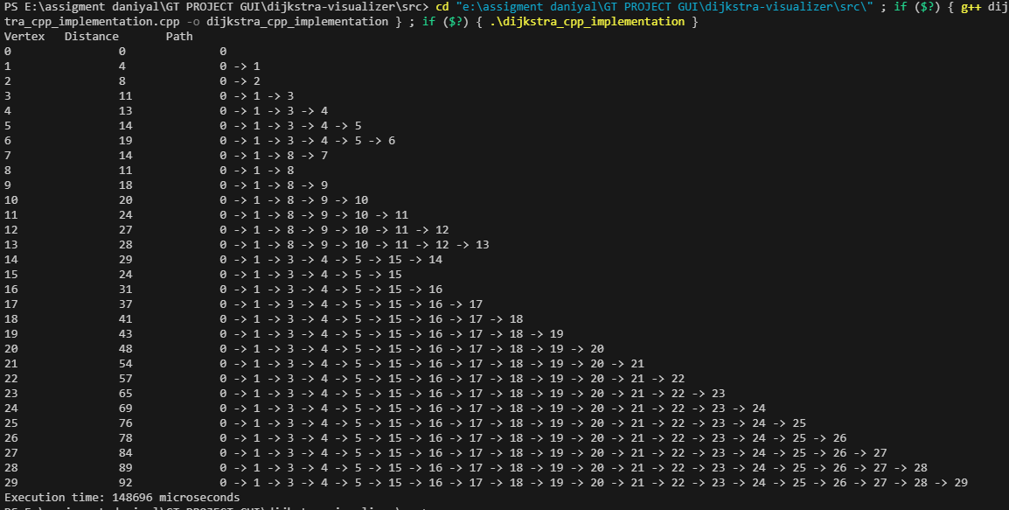
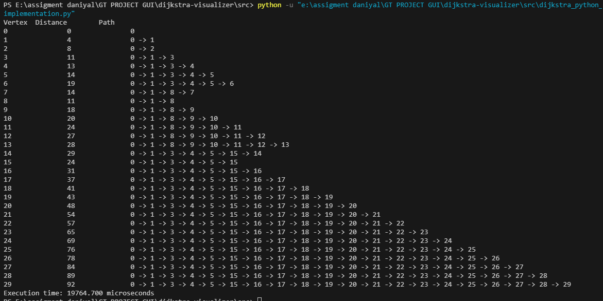
CPP: 148,696 µs
Python: 19,764.7 µs

Slide 9
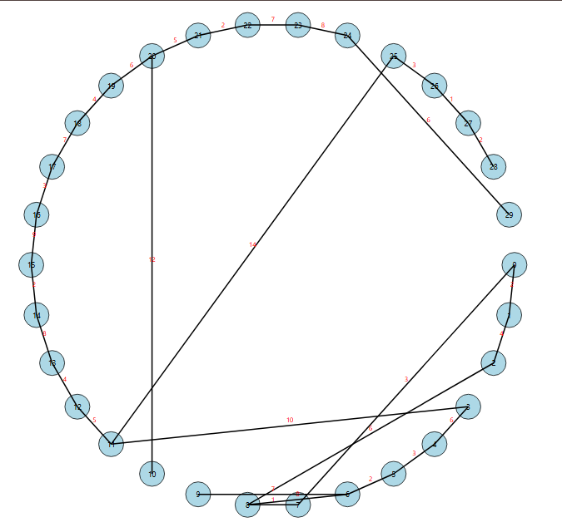
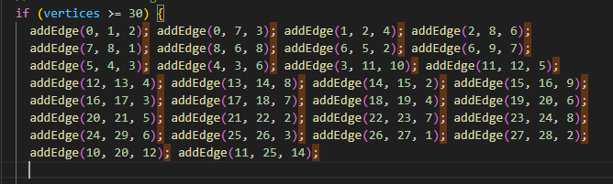
Test Case # 3

Slide 10
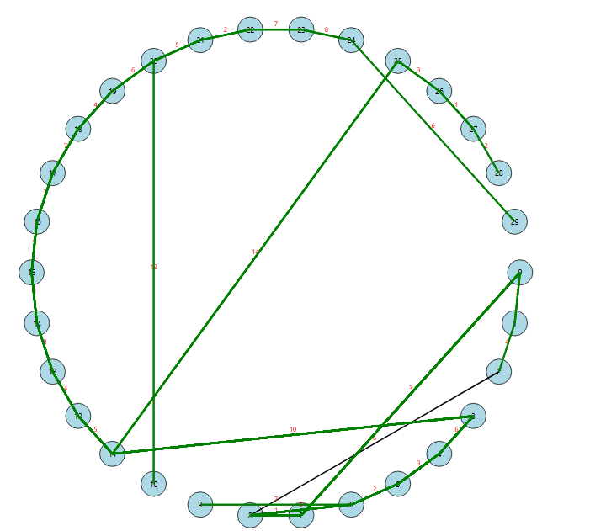
Test #3
CPP: 250,612 µs
Python: 80,676.1 µs
Python is ~67.79% faster than CPP

Slide 11
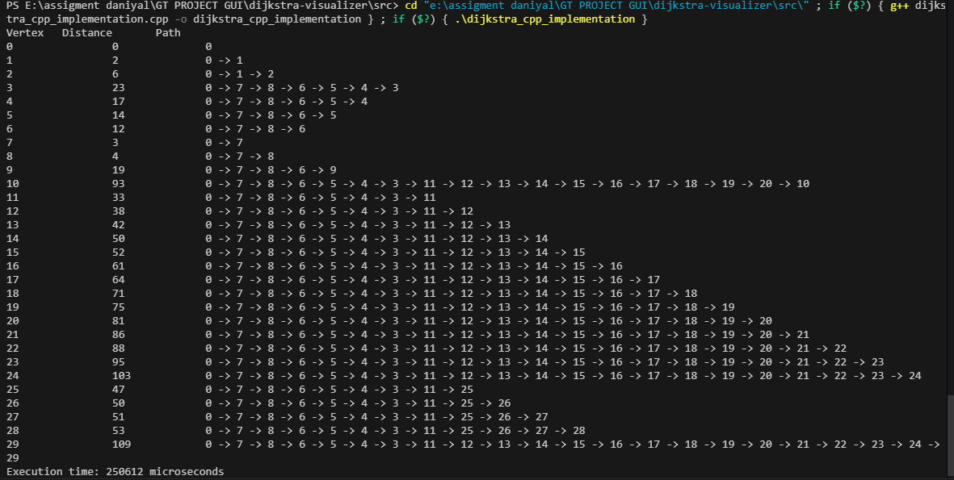
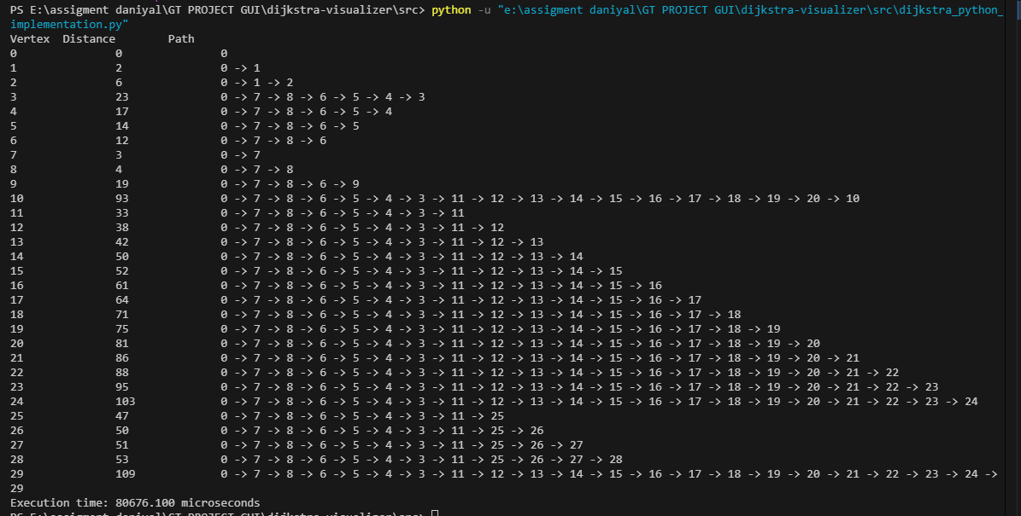
CPP: 250,612 µs
Python: 80,676.1 µs

Slide 12
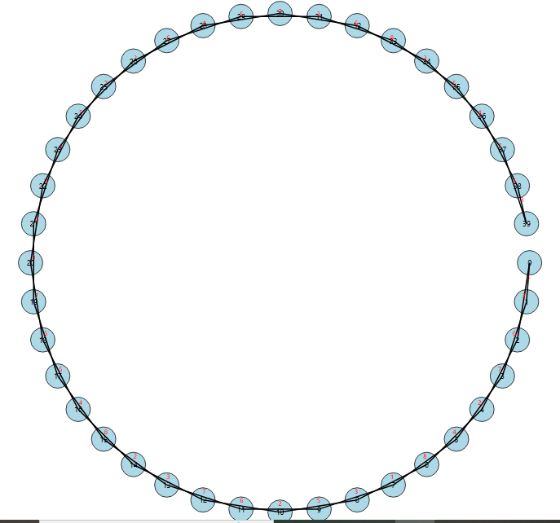
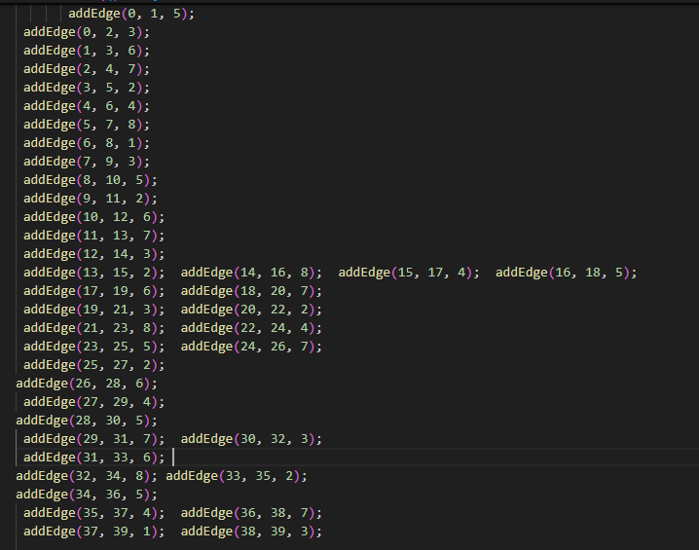
Test Case # 4

Slide 13
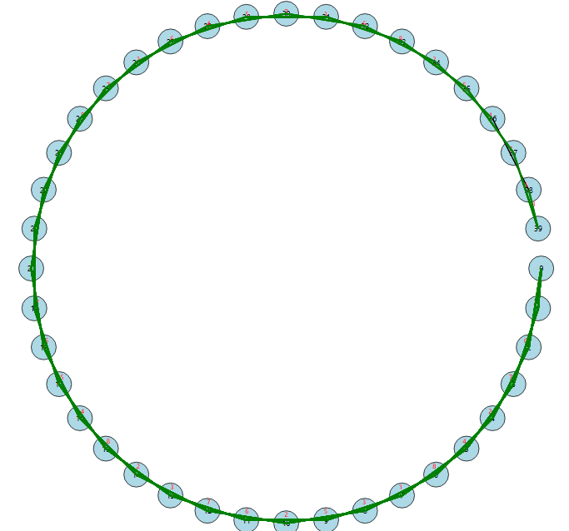
Test #4
CPP: 649,689 µs
Python: 135,166.7 µs
Python is ~79.20% faster than CPP

Slide 14
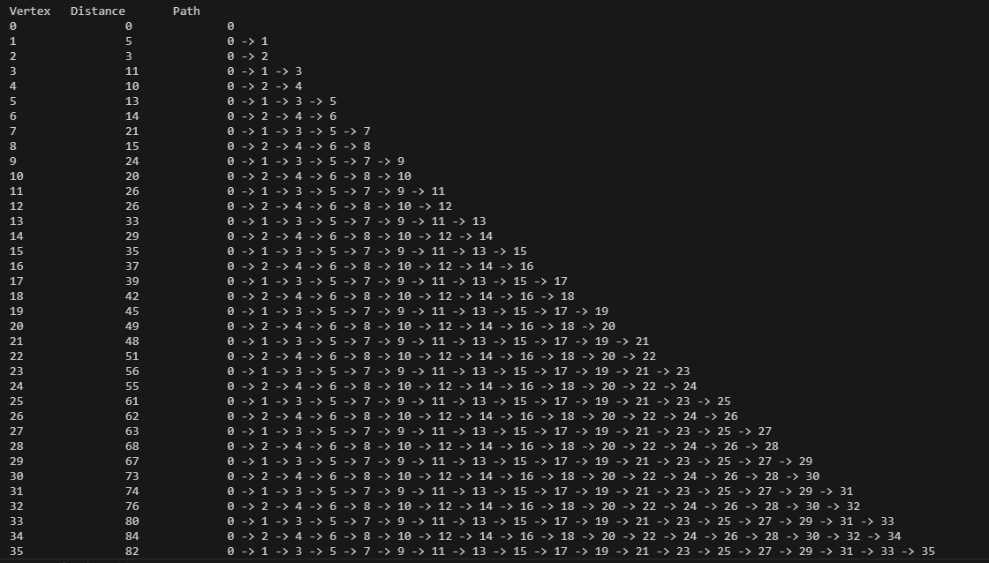
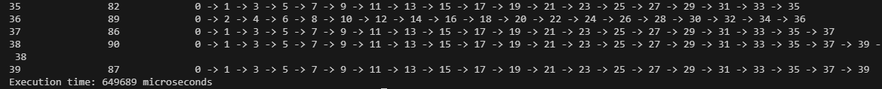
CPP: 649,689 µs

Slide 15
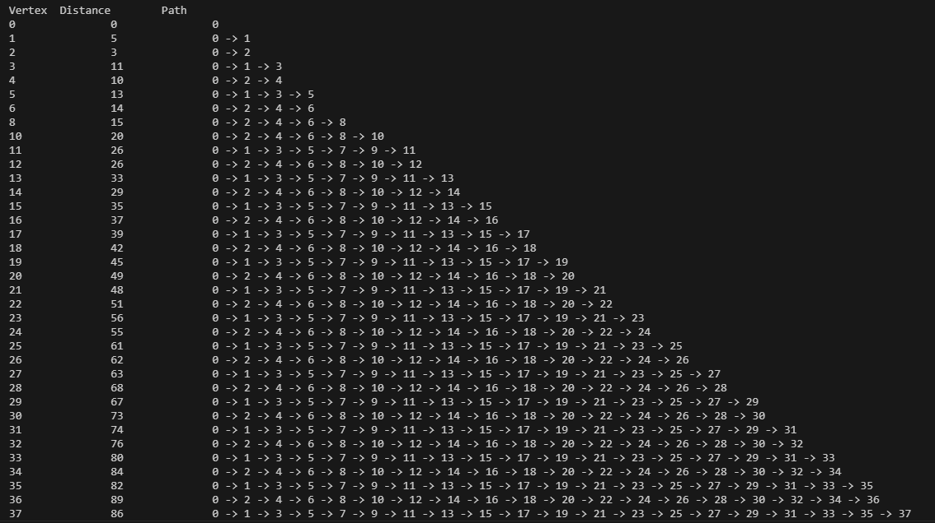
Python: 135,166.7 µs

Slide 16
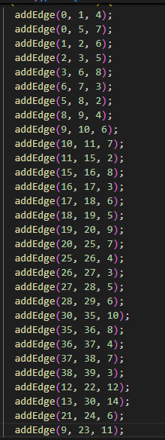
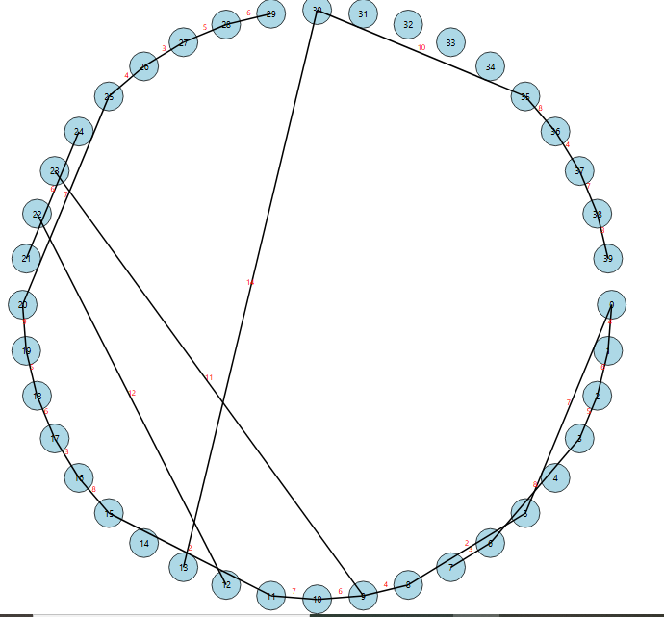
Test Case # 5

Slide 17
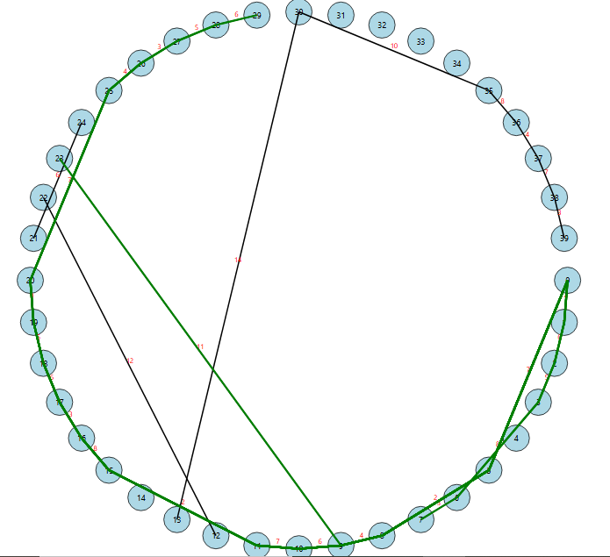
Test #5
CPP: 240,703 µs
Python: 44,986.2 µs
Python is ~81.30% faster than CPP

Slide 18
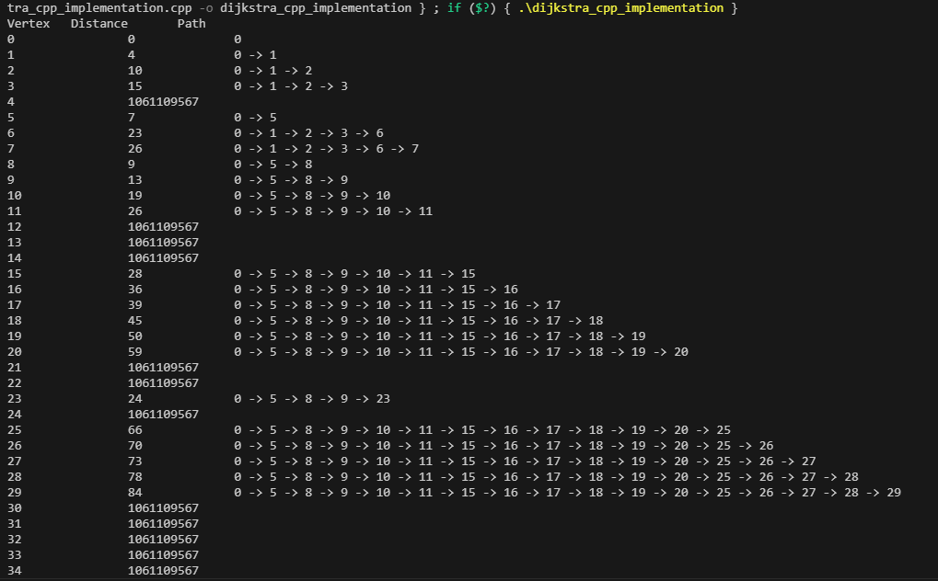
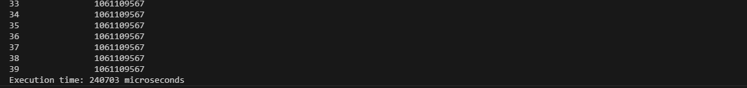
CPP: 240,703 µs

Slide 19
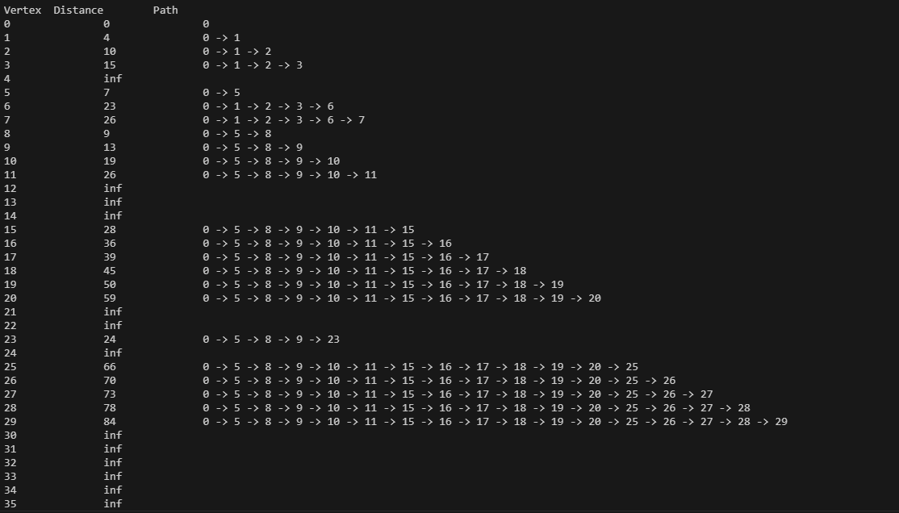
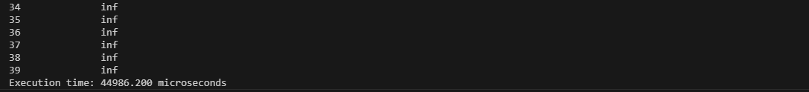
Python: 44,986.2 µs

Slide 20
GT Project Report
Test Cases
Test #1
CPP: 432,254 µs
Python: 411,553.6 µs
Python is ~4.78% faster than CPP
Test #2
CPP: 148,696 µs
Python: 19,764.7 µs
Python is ~87.71% faster than CPP
Test #3
CPP: 250,612 µs
Python: 80,676.1 µs
Python is ~67.79% faster than CPP
Test #4
CPP: 649,689 µs
Python: 135,166.7 µs
Python is ~79.20% faster than CPP
Test #5
CPP: 240,703 µs
Python: 44,986.2 µs
Python is ~81.30% faster than CPP
Test #6
CPP: 32,783 µs
Python: 13,680.2 µs
Python is ~58.26% faster than CPP
Test #7
CPP: 27,506 µs
Python: 9,298.6 µs
Python is ~66.20% faster than CPP
Test #8
CPP: 22,427 µs
Python: 11,755.6 µs
Python is ~47.59% faster than CPP

Slide 21
Test #8 b
CPP: 11,406 µs
Python: 9,848.9 µs
Python is ~13.64% faster than CPP
Test #9
CPP: 190,365 µs
Python: 38,823.1 µs
Python is ~79.61% faster than CPP
Test #10
CPP: 8,209 µs
Python: 4,287.2 µs
Python is ~47.77% faster than CPP
Click Below to see the detailed working of all the mentioned cases
GT Project Report

Slide 22
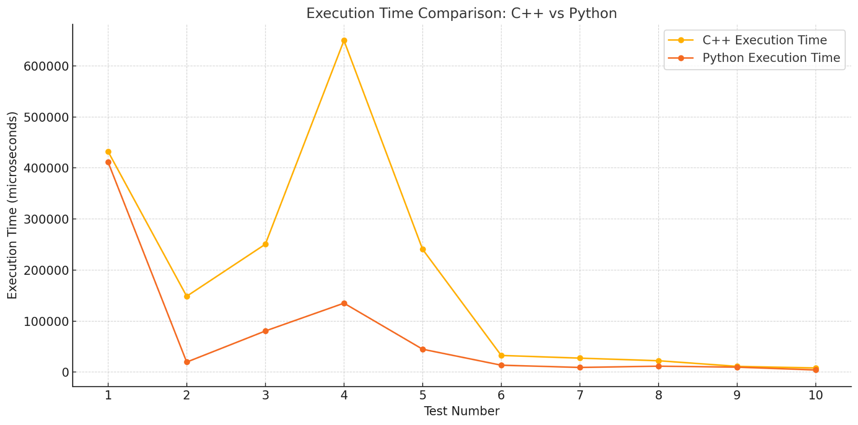
Graph Analysis Of Test Cases
C++ spikes in execution time for larger graphs due to adjacency list inefficiencies.
Python's smoother execution trend, though slower for smaller inputs.

Slide 23
Execution Time Trends:
C++ generally has faster execution times than Python across most tests.
However, in certain larger cases, C++ shows unexpectedly high execution times compared to Python.
Test Results Summary:
Small Graphs: C++ consistently outperforms Python due to its highly optimized compiler and low-level memory access.
Larger Graphs: In some tests, C++ shows performance spikes compared to Python.
1. Compiler and Runtime Differences
C++: Compiled to machine code, optimizing performance for numerical and iterative operations.
Python: Interpreted language, inherently slower due to dynamic typing and garbage collection overhead.
2. Algorithm Complexity
Both implementations have O(V²) complexity due to the brute-force selection of the next node.
Python's implementation may perform better on certain test cases due to differences in how adjacency lists and loops are processed in memory.

Slide 24
3. Memory Management
C++: Directly manages memory, but improper handling of data structures (e.g., adjacency lists) can cause inefficiencies for larger data.
Python: Uses automatic memory management (garbage collection), which may reduce overhead in small test cases.
4. Input Handling
Python's dictionaries and lists are optimized for sparse data, potentially handling adjacency lists more efficiently than raw arrays or linked lists in C++.
5. Timing Anomalies
C++ Timing Hike: Likely caused by how the std::chrono library captures time intervals, or due to overhead from dynamic memory allocation in std::list operations.
Python: time.perf_counter is less prone to such anomalies.

Slide 25
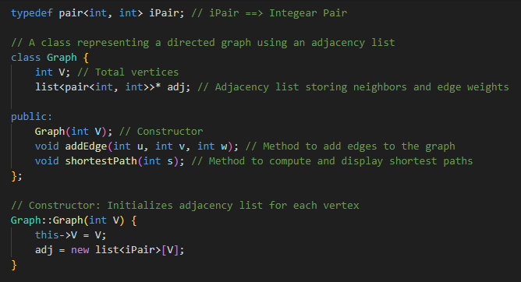
ALGORITHM

Slide 26
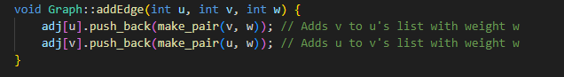
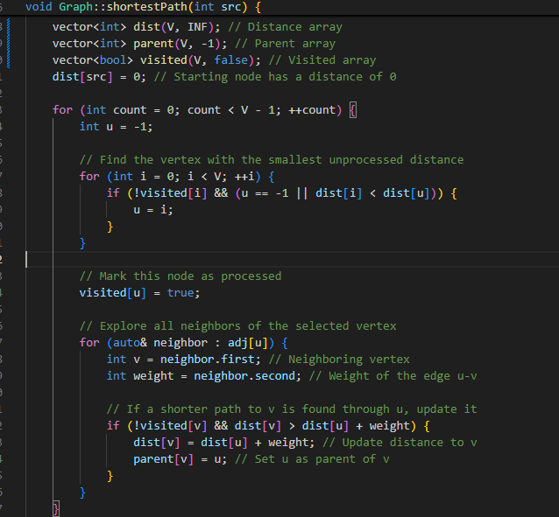

Slide 27
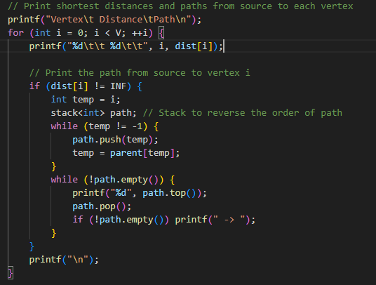

Slide 28
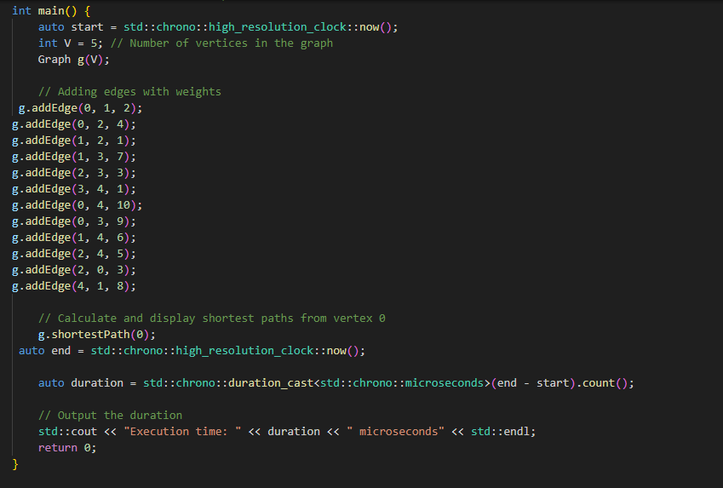

Slide 29

Thank You
Members:
Daniyal Fahim 22k-4282
Daiyan Ur Rehman 22k-4167
Dawood Adnan 22k-4663

